Slide 1
Predicting
Supreme Court Decision
with Neural Network
BA865 Team Project
Eunjin Jeong, Yesol Lee, Yongxian Lun, Ji Qi

Slide 2




Meet Team
Yesol Lee
(Sally)
Ji Qi
Yongxin Lun
(Caroline)
Eunjin Jeong

Slide 3
01.
03.
05.
Introduction
Dense Layer Model
Text Vectorization Layer
02.
04.
06.
Dataset Overview
1D CNN Model
RNN Model
Background
Problem Statement
Simple Neural Network Model
With Dense laysers
Simple Neural Network Model
With Dense laysers
Data structure & source
Applying 1D Convolutional
Network for Text Data
Simple Neural Network Model
With Dense laysers

Slide 4
01.
INTRODUCTION

Slide 5

Introduction - Background & Problem statement
Background
The Court is the highest tribunal for all cases and interpretation of the Constitution or the laws in the United States. Supreme court decisions impact parties in each case, stakeholders, government and society. Supreme court decisions regulate individuals' life, rights and obligations.
Problem Statement
To predict the winning party(petitioner, respondent) of each supreme court case using neural network model

Slide 6
2.
Data overview &
Preprocessing

Slide 7
Data Source & Features
Source
Features
Oyez Project
Free law project from Cornell’s Legal Information Institute, Justia, and Chicago-Kent College of Law to archive Supreme Court data.
Index ID
Name (same as first/second party)
href
First party(Petitioner)
Second party(Respondent)
Facts
Winning party
Winner index(0,1)
Predictors
Labels

Slide 8
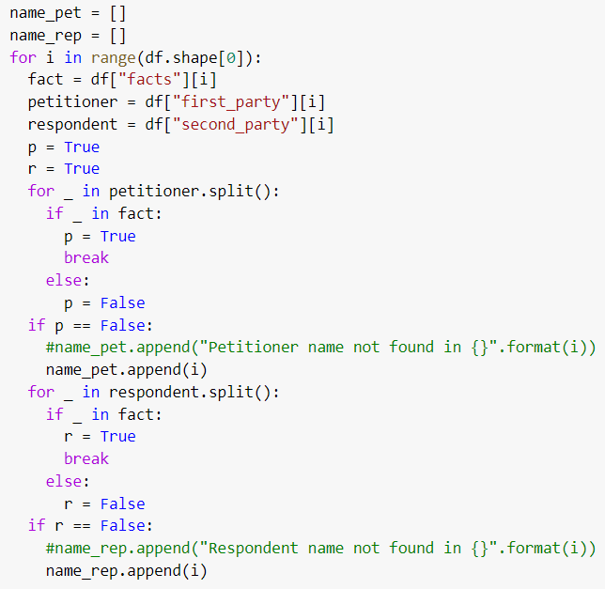
Feature engineering
Combine ‘fact’ with
‘First_party’+‘ ’+‘second_party’
13.05% of facts don't contain the first party name
17.18% of facts don't contain the second party name
1.93% of facts don't contain both first party the second party names

Slide 9
Addressing data imbalance
Original Data
Balancing
Final Train Data
Imbalance winner index column
0: 2114 data points (61.03%)
1: 1350 data points (38.97%)
Total 3464 cases
Train-Test Split 80:20
Upsample minor class (winner index=1) using Sklearn resample
0: 1689 data points (50%)
1: 1689 data points (50%)
3378 train data/693 Test data

Slide 10
3.
Dense Layer
Model

Slide 11
Process
Step1: Vectorize Facts column by using Doc2Vec method
Vectorize Paragraphs instead of word
Step2: Train Dense Layer model using training data and cross validation
Combine dense layers and several overfitting delaying techniques
Step3: Evaluate the model with the test data

Slide 12
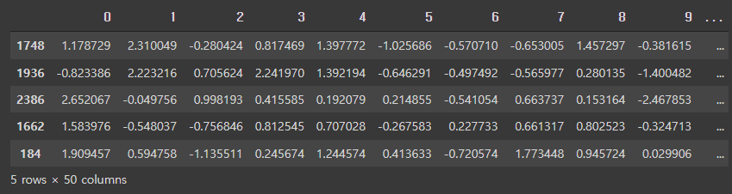
STEP 1. Doc2Vec
doc2vec_model = Doc2Vec(vector_size=50, min_count=2, epochs=40, dm=1, seed=865, windows=5)
Prepare data for Doc2Vec model
Tokenize text data
Tagged Document
Defined Doc2Vec Model
Vectorize the text data
Train the model with Train data
Infer vector by the trained model
Preview of vectorized data

Slide 13
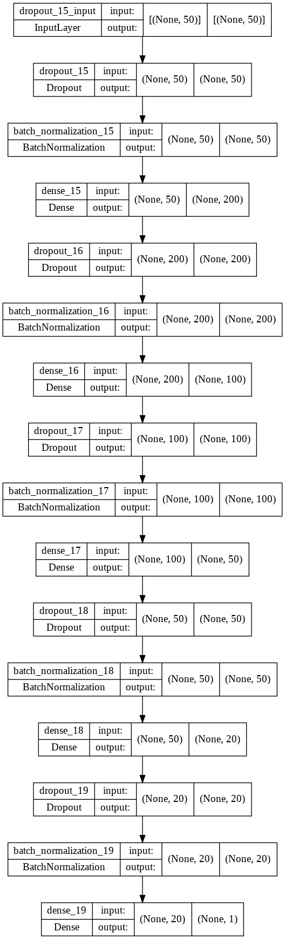
STEP 2. Modeling
Key information about the Model
Layer type: Dense Layer
Output activation function: Sigmoid
Loss function: binary_crossentropy
Optimizer: Adam
Prevent Overfitting
Drop out
Batch Normalization
Kernel Regularizer

Slide 14
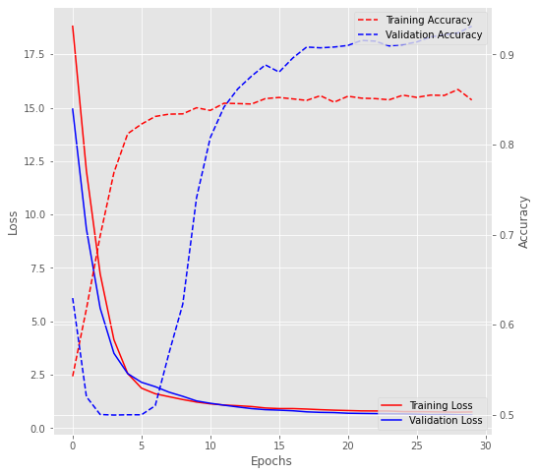
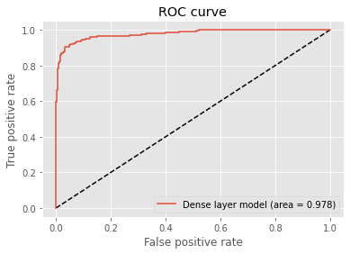
STEP 3. Evaluate the Model
Validation Accuracy: 0.7847
Test Accuracy: 0.9033
Area Under the Curve = 0.978

Slide 15
4.
1D Convolutional
Network

Slide 16
Process
Step1: Vectorize Facts data by using TextVectorization Layer
Vectorize based on unigram
Step2: Train 1D CNN model using training data and cross validation
CNN related layers, Embedding layer, Dense layer
Step3: Evaluate the model with the test data

Slide 17
STEP 1. Text Vectorization
Define Text Vectorization layer
Train Data Tensor shape
after processing
= (3382, 500)
No ngram
Standardize output length
Output integer indices
text_vectorization = keras.layers.TextVectorization(
max_tokens=2000, output_mode="int",output_sequence_length = 500)
text_vectorization.adapt(X_train)

Slide 18
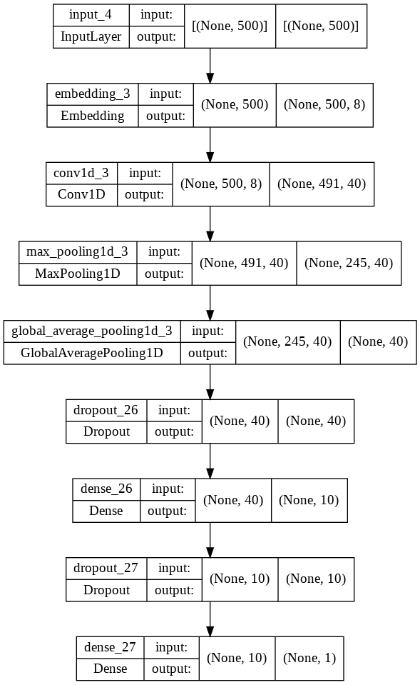
STEP 2. Modeling
Key information about the Model
Layer type: Conv1D, MaxPool1D, GlobalAveragePooling1D, Embedding, Dense layer
Output activation function: Sigmoid
Loss function: binary_crossentropy
Optimizer: Adam
Prevent Overfitting
Drop out

Slide 19
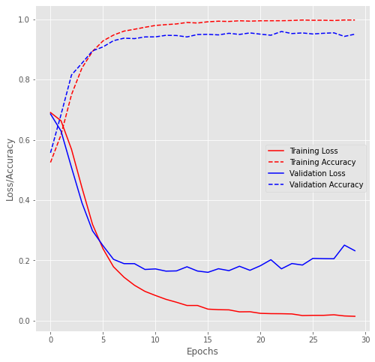
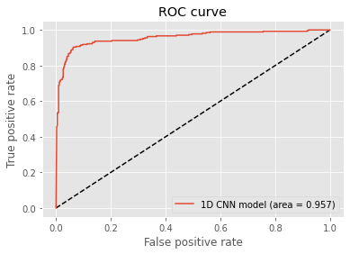
STEP 3. Evaluate the Model
Validation Accuracy: 0.9155
Test Accuracy: 0.9120
Area Under the Curve = 0.957

Slide 20
5.
Text Vectorization
Layer

Slide 21
STEP 1. Text Vectorization
Text Vectorization Layer
keras.layers.TextVectorization
(
ngrams=2,
max_tokens=20000,
output_mode = "tf_idf"
)
Ngrams = 2
Max_tokens = 20000
Output_mode = “tf_idf”
Notes:
Here we processed our text with a TextVectorization Layer. Process text-words as bag-of-words approach by looking at groups of consecutive token like bigram. So we passed an ngrams = 2 argument in the layer.. Here we are limiting the vocabulary to the 20,000 most frequent words because in general, 20,000 is the right vocabulary size for text classification. Otherwise, we’d ve indexing every word in the training data, potentially thousands of terms that only occur once of twice and thus are not informative. And the it returns TF-IDF -weighted outputs.

Slide 22
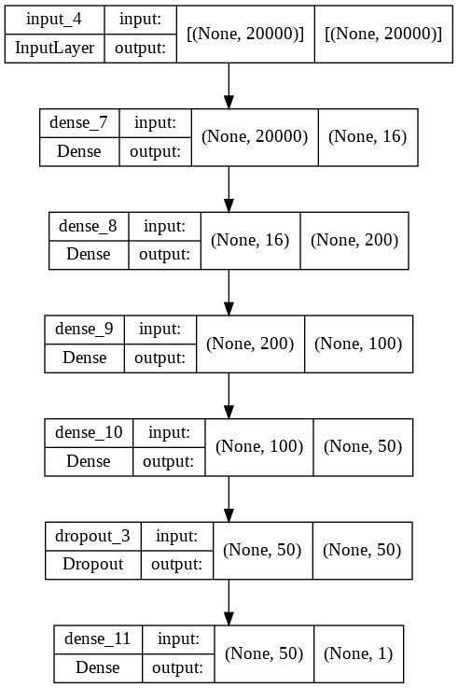
STEP 2. Model
TF-IDF Bigram Model
Several dense layers and dropout method
Output activation function: sigmoid
Metrics: accuracy
Cross validation
Notes:
Next Step in the model evaluation, we trained and tested the TF-IDF bigram model. We have several dense layers with relu, and tanh as hidden layers, and then we have drop out method to mitigate overfitting. We chose output activation function as sigmoid since it’s a classification task to classify whether first or second party is winner. Second, we chose accuracy as the metrics. Last, we used k= 4 folds to conduct cross validation.

Slide 23
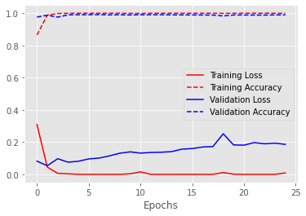
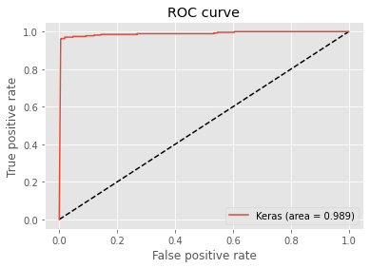
STEP 3. Model Results
Validation Accuracy: 0.9883
Test Accuracy: 0.9885
Area = 0.989
Notes:
The model gets us to a validation accuracy of 98.8%, and a test accuracy of 98.85%. The graphs shows a pretty steady trends and training acc and test acc is almost overlaps, even, ROC score is up to 0.898. The reasons that we have such a high score, it’s due to the ratio between the number of samples in the training data and the mean number of words per sample is 3, way less than 1500. Then the bag of bigrams model will perform better. But later on, we will also compare with RNN models to have a better understanding.

Slide 24
6.
RNN
Model

Slide 25
Process (RNN without Textual Embeddings)
Step1: Vectorize Facts column by using TextVectorization layer and one_hot encoding layer
Step2: Add Bidirectional LSTM Layer to capture more information
Step3: Train RNN model using training data and cross validation and Combine dense layers and several overfitting delaying techniques
Step4: Evaluate the model with the test data
Notes:
In fact, before we use the RNN models, we checked the ratio of observations in training to mean number of tokens per sample equal to 3 (< 1500). Thus, We can’t expect to get much value using a sequence model, since we would need a larger dataset (1,500,000 samples). But, we still try to add RNN layers to validate our hypothesis by comparing accuracy and AUC scores.

Slide 26
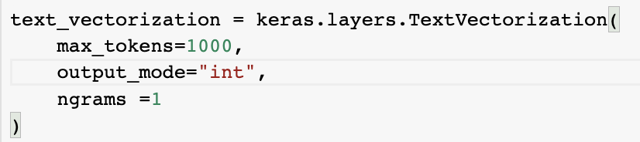
STEP 1 & 2. TextVectorization layer and RNN layer
TextVectorization layer
Bidirectional LSTM layer
Notes:
maximum tokens are set to 1000 words
This is requesting integer encodings (which means we'll have a sequence of integers)
set ngram = 1 (which means we will consider the sequence of the documents)
Set units = 16
operating in parallel and generate 32 LSTM (embeddings) in the end

Slide 27
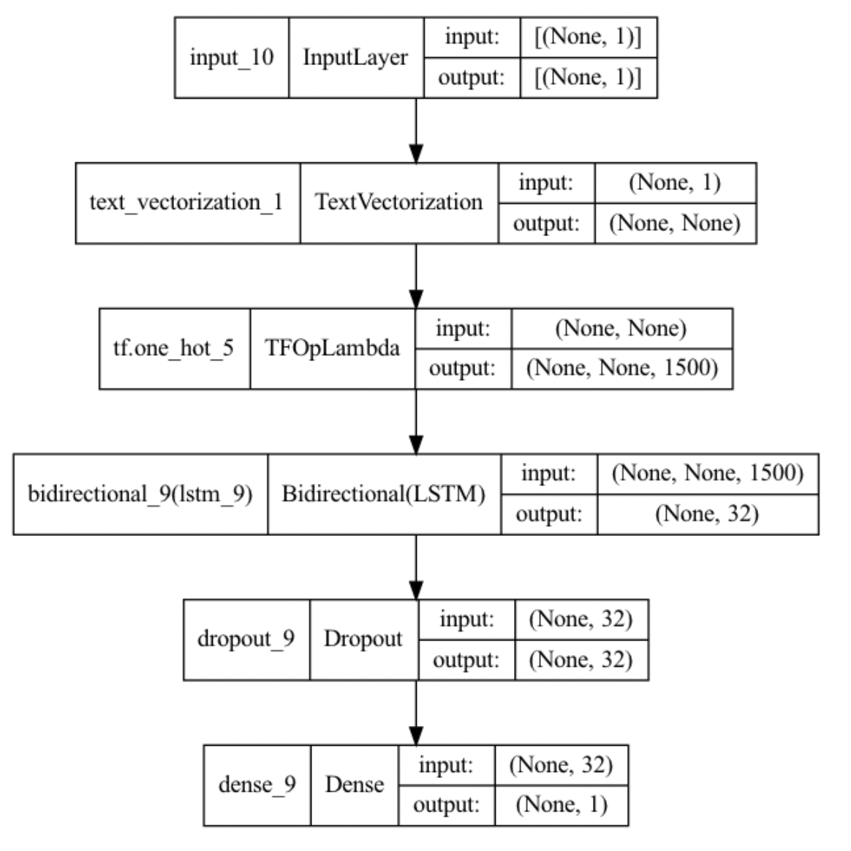
STEP 3. Modeling
Key information about the Model
Layer type: Bi-LSTM + Dense Layer
Output activation function: Sigmoid
Loss function: binary_crossentropy
Optimizer : RMS Props
Prevent Overfitting
Drop-out layer
Notes:
sigmoid : output is continuous from 0 to 1 exclusive
Binary cross entropy classification for binary outcome
RMS Props: accelerate the optimization process

Slide 28
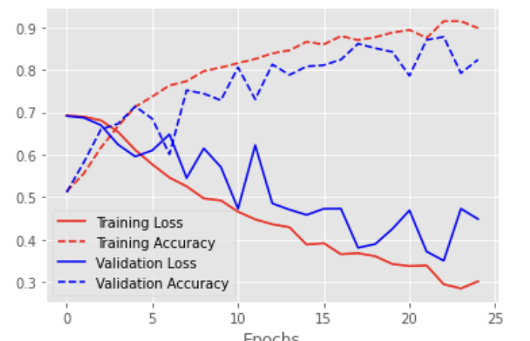
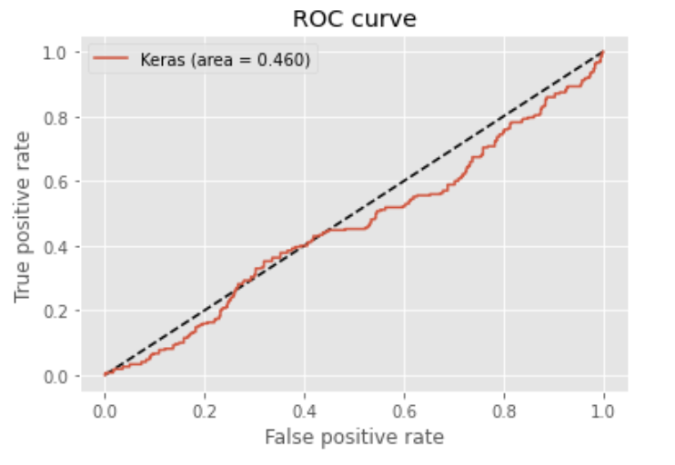
STEP 3. Evaluate the Model
Validation Accuracy: 0.75
Test Accuracy: 0.6104
Area Under the Curve = 0.460
Notes:
AUC below 0.5 and test accuracy around 0.61 shows that our dataset is not suitable for RNN models since the lack of data

Slide 29
Process (Textual Embeddings)
Step1: Vectorize Facts column by using TextVectorization layer and one_hot encoding layer
Step2: Add Bidirectional LSTM Layer to capture more information
Step3: Add Textual Embedding Layer ()
Step4: Train RNN model using training data and cross validation and Combine dense layers and several overfitting delaying techniques
Step5: Evaluate the model with the test data

Slide 30
STEP 1 & 2. TextVectorization layer and RNN layer
TextVectorization layer
Bidirectional LSTM layer
Notes:
maximum tokens are set to 1000 words
This is requesting integer encodings (which means we'll have a sequence of integers)
set ngram = 1 (which means we will consider the sequence of the documents)
Set units = 16
operating in parallel and generate 32 LSTM (embeddings) in the end

Slide 31
STEP 3. Textual Embedding layer
We are setting 1000 as the vocabulary size, as we will be encoding numbers 0 to 999.
We want the length of the word vector to be 8, hence output_dim is set to 8.
The length of the input sequence to embedding layer will be 500.
Truncates after 500 tokens, and pads up to 500 tokens for shorter facts.
Mask zero means it will skip 0 tokens and will not pass them on.

Slide 32
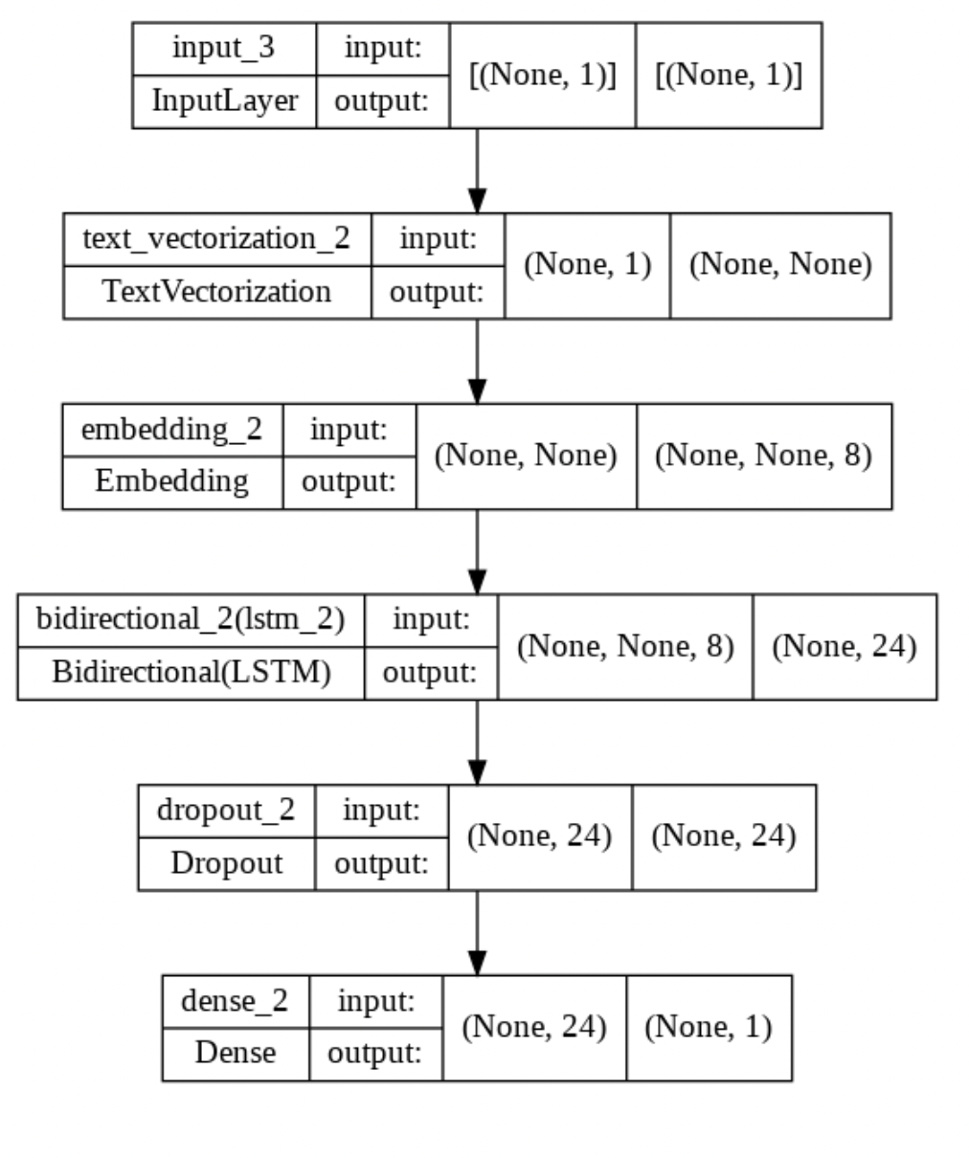
STEP 4. Modeling
Key information about the Model
Layer type: Textual Embeddings + Bi-LSTM + Dense Layer
Output activation function: Sigmoid
Loss function: binary_crossentropy
Optimizer : RMS Props
Prevent Overfitting
Drop-out layer
Notes:
sigmoid : output is continuous from 0 to 1 exclusive
Binary cross entropy classification for binary outcome
RMS Props: accelerate the optimization process

Slide 33
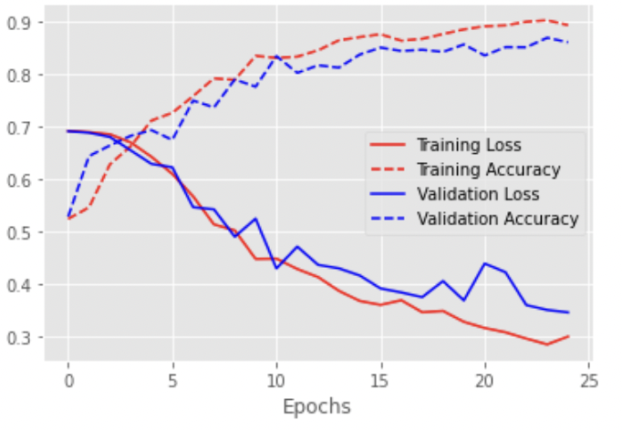
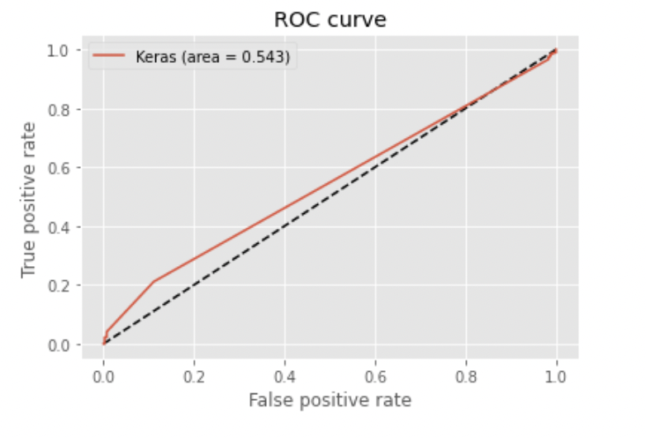
STEP 5. Evaluate the Model
Validation Accuracy: 0.7904
Test Accuracy: 0.6103
Area Under the Curve = 0.543
Notes:
AUC around 0.5 and test accuracy around 0.61 shows that our dataset is not suitable for RNN models since the lack of data

Slide 34
7.
Conclusion

Slide 35
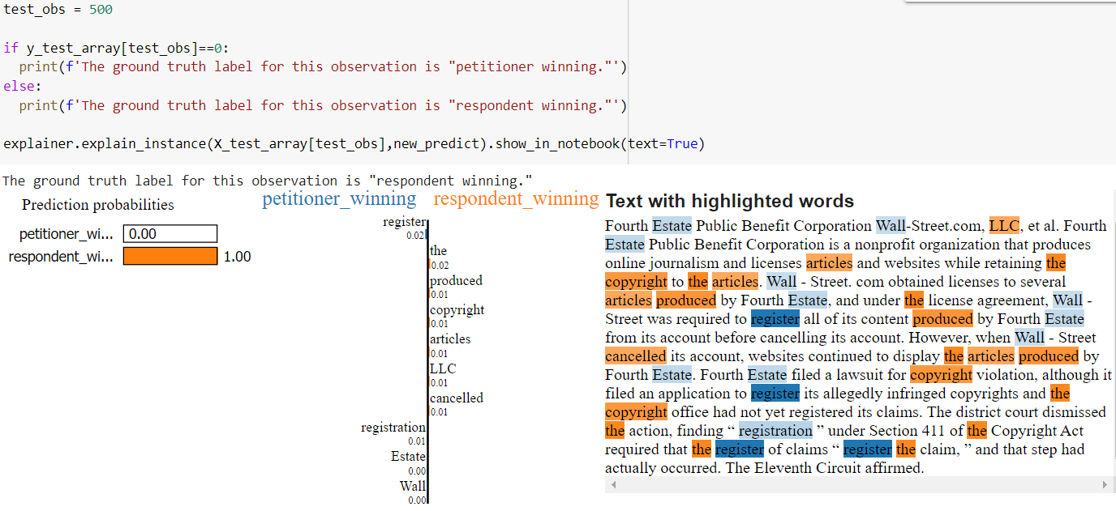
Model interpretation - LIME
Model | Accuracy | AUC
Dense + Doc2Vec | 0.9033 | 0.978
1D convolution | 0.9120 | 0.957
Dense + Text vectorization | 0.9885 | 0.989
Bidirectional LSTM | 0.6104 | 0.460
Textual Embedding | 0.6104 | 0.543
Pretrained Embedding | 0.8297 | 0.922
Notes:
The ratio of observations in training to mean number of tokens per sample
May need a bigger dataset about 1,461,000 samples
The average fact in our data has 974 words, and we have 3464 samples.
The ratio of samples to average sample length is 4. We are nowhere close to 1500.

Slide 36
Limitation & Suggestion
Cross-Validation & Upsample
Domain specific model
Gather more features
Upsampling in each folds
Domain specific pretrain model: legal corpuses
ex) leGloVe
Oyez database: advocate, location, lower court and date
Notes:
You can download a pre-trained model containing 100-dimensional word vectors here: LeGlove.model.zip. The model was trained on 63,981 Supreme Court opinions (scotus) from 1789 to 2014. Judicial opinion data is made available through CourtListener, courtesy of the Free Law Project.

Slide 37
THANK YOU!
Do you have any questions?

